Slide 1


Str ll
Let’s take a stroll…

Slide 2

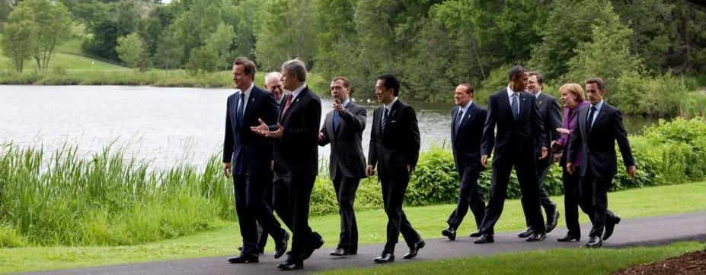
Hard to stay focused
Loss of stimulation
Not engaging
Take the meeting on a Stroll
Lots around for more stimulation
More engaging

Slide 3

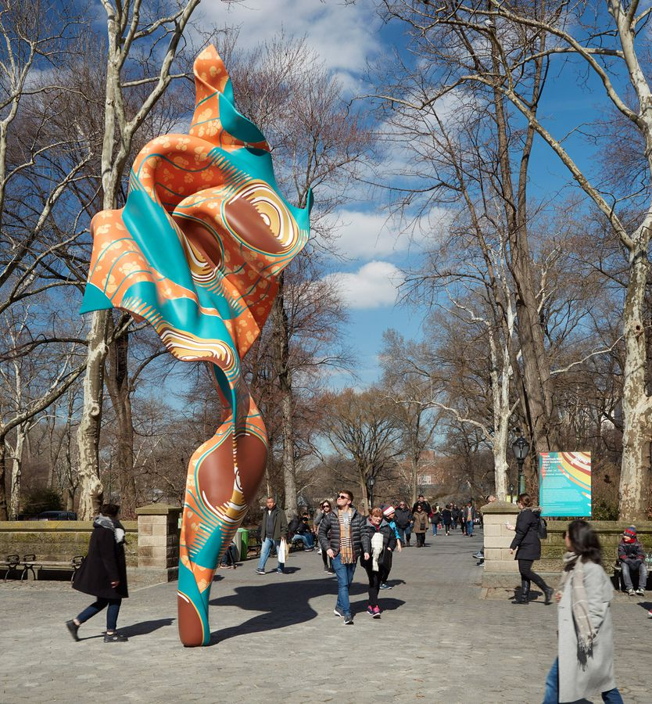
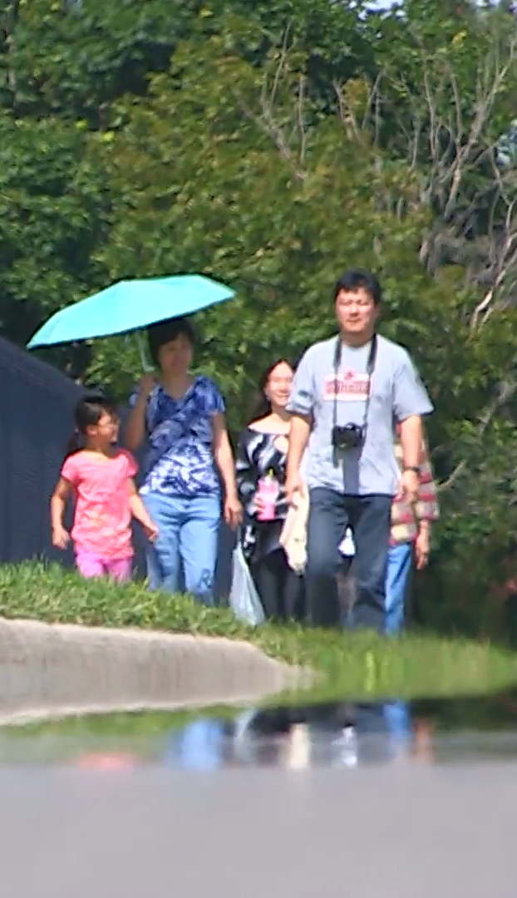

Time managed walk
Most engaging walk
Staying in or out of the Sun
Unfamiliar area

Slide 4
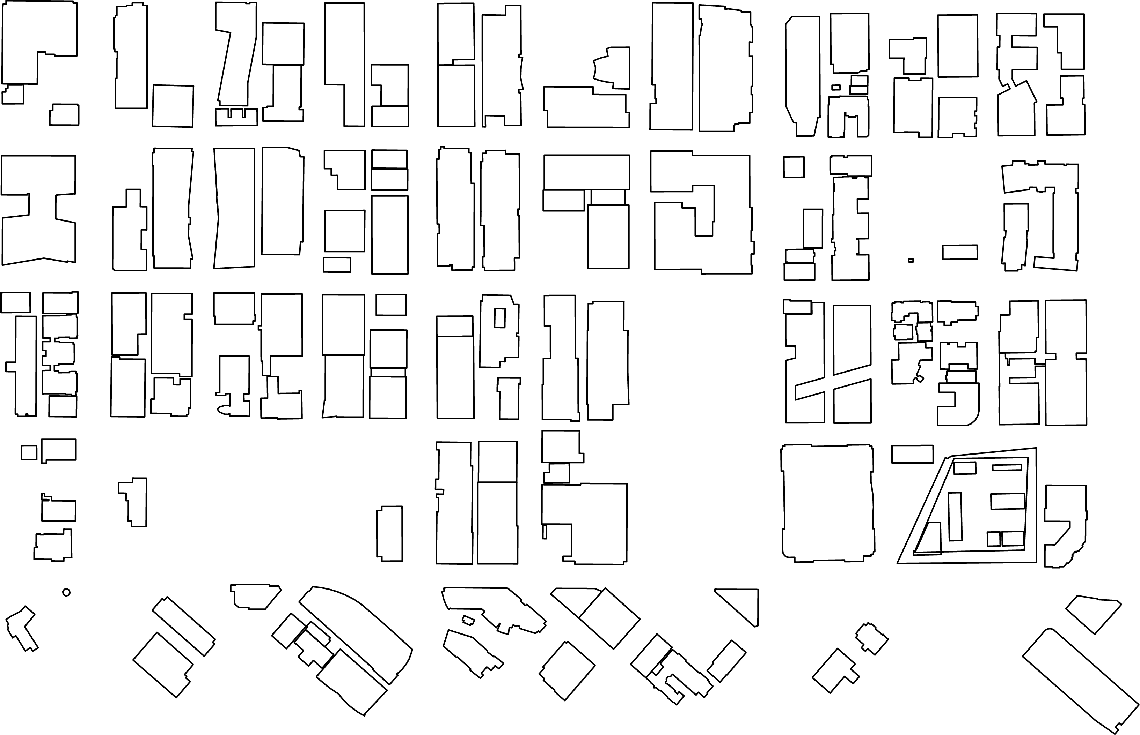
Take a Stroll anywhere!!
Your Office
Client’s Office
University Campus

Slide 5
Time managed walk
Most engaging walk
Staying in or out of the Sun
Unfamiliar area
10 min

Slide 6
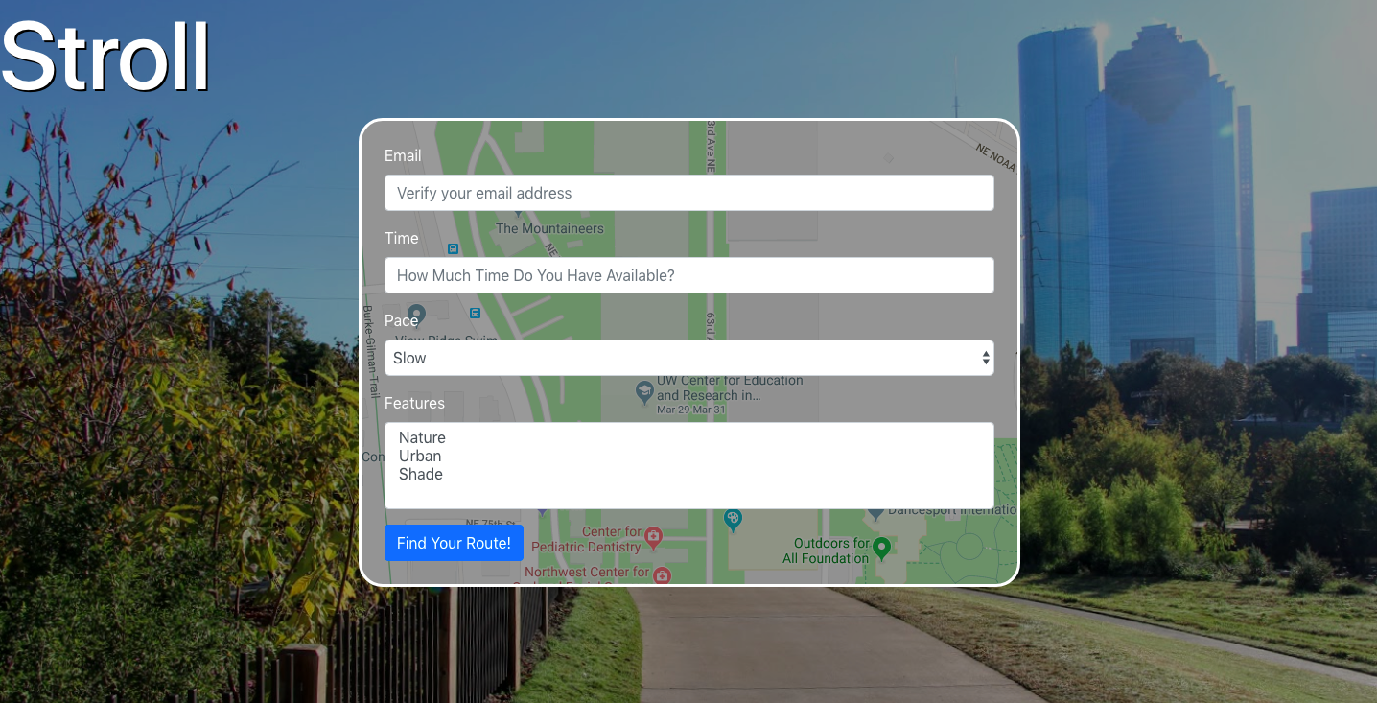

Slide 7
